Slide 1
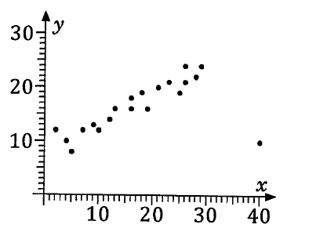
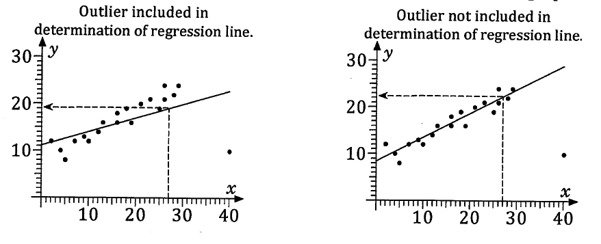
Unit 3 Chapter 2C
Looking at the scatter graph, we can see that the point (40, 10) doesn’t ‘fit’ the strong positive linear correlation suggested by the other points. We can say that (40, 10) is an outlier.
Outliers can significantly affect the line of best fit.
We can see this below where the line of best fit has been calculated including the outlier, and then excluding the outlier. The predicted y-value for an x-value of 27 differs from 19 to 22 accordingly.

Slide 2
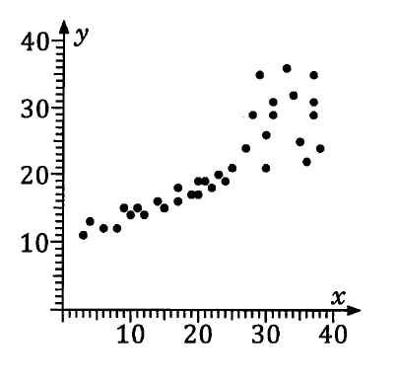
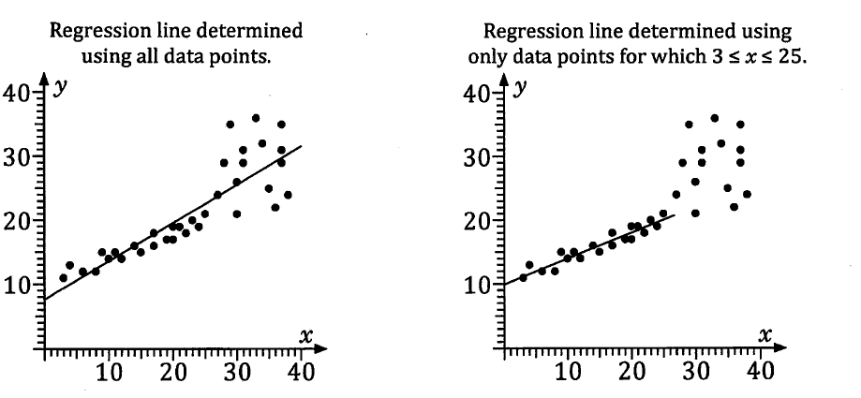
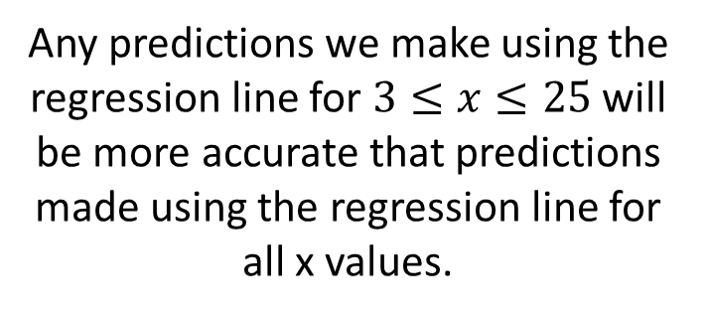
Unit 3 Chapter 2C
When looking at a scatter plot containing an outlier, we can choose to remove the outlier when evaluating the data, by trimming or cropping the data.
The linear trend for this scatter plot seems not to apply to x values over 25.
If we wanted to predict y values based on x values under 25, we can crop the data so that the line of best fit only looks at x values between 3 and 25. (This would alter the position of our regression line).
Any predictions we make using the regression line for $3≤x≤25$ will be more accurate that predictions made using the regression line for all x values.

Slide 3
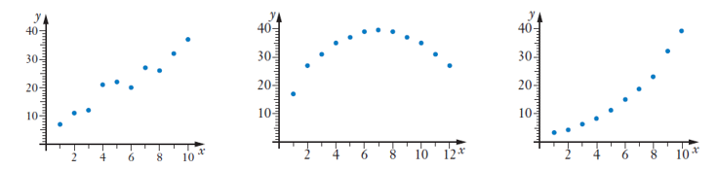
Unit 3 Chapter 2C
We have looked at linear correlation where a straight line best fits the bivariate data, and we have used linear regression to predict values.
A straight line doesn’t always ‘best fit’ the bivariate data.
Shape suggests a linear (straight line) model is appropriate
Shape suggests a quadratic model is more appropriate
Shape suggests an exponential model is more appropriate

Slide 4
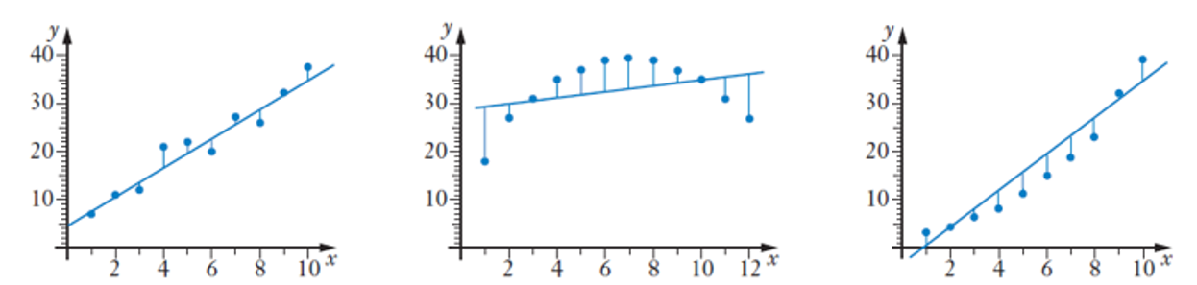
Unit 3 Chapter 2C
If we try to fit straight lines to all three sets of bivariate data, we can see that the residuals $(y−\hat{y})$ are random for the scatter plot that actually fits a linear model, but follow a pattern for the others.
Residuals are random (some above and some below)
Residuals are increasingly negative for high and low values and positive in the middle
Residuals are negative in the middle and positive for high and low values

Slide 5
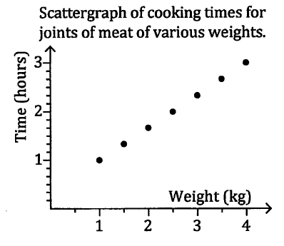
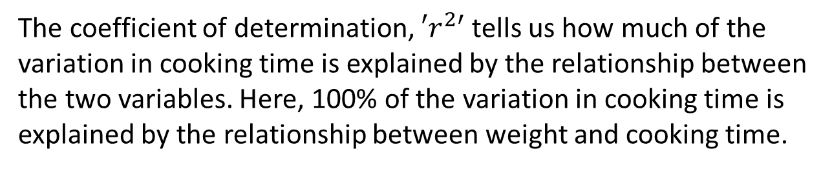
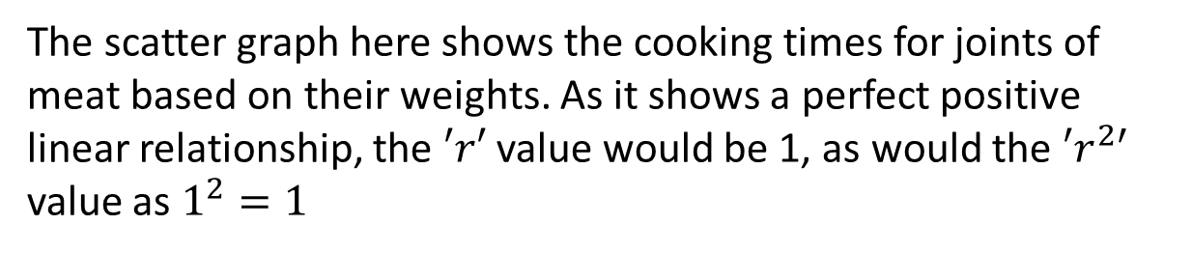
Unit 3 Chapter 2C
Our ClassPad display gives the equation of the line of best fit, but also gives values for ‘$r$’, the correlation coefficient, and ‘$r^{2}$’, the coefficient of determination.
The scatter graph here shows the cooking times for joints of meat based on their weights. As it shows a perfect positive linear relationship, the $′r′$ value would be 1, as would the ${′r}^{2′}$ value as $1^{2}=1$
The coefficient of determination, ${′r}^{2′}$ tells us how much of the variation in cooking time is explained by the relationship between the two variables. Here, 100% of the variation in cooking time is explained by the relationship between weight and cooking time.

Slide 6
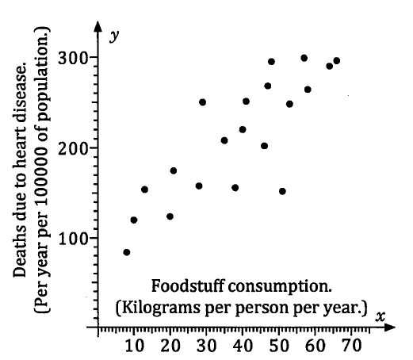
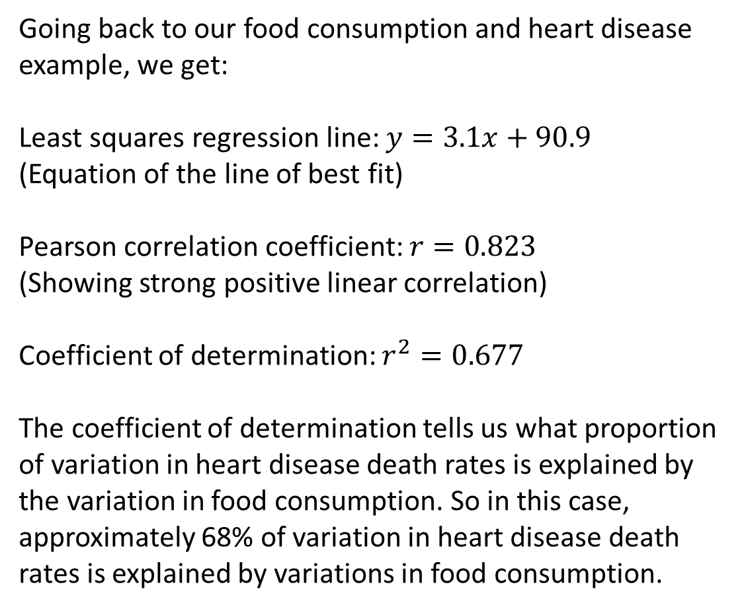
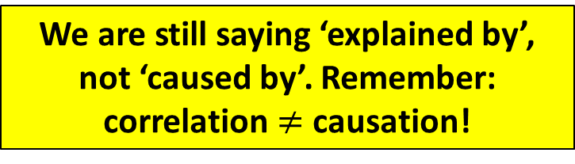
Unit 3 Chapter 2C
Going back to our food consumption and heart disease example, we get:
Least squares regression line: $y=3.1x+90.9$
(Equation of the line of best fit)
Pearson correlation coefficient: $r=0.823$
(Showing strong positive linear correlation)
Coefficient of determination: $r^{2}=0.677$
The coefficient of determination tells us what proportion of variation in heart disease death rates is explained by the variation in food consumption. So in this case, approximately 68% of variation in heart disease death rates is explained by variations in food consumption.
We are still saying ‘explained by’, not ‘caused by’. Remember: correlation $≠$ causation!

Slide 7
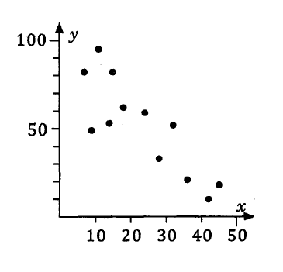

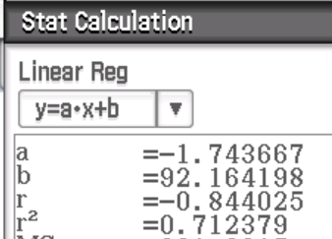
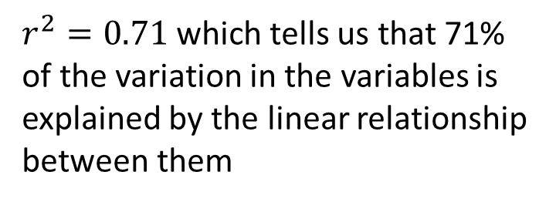
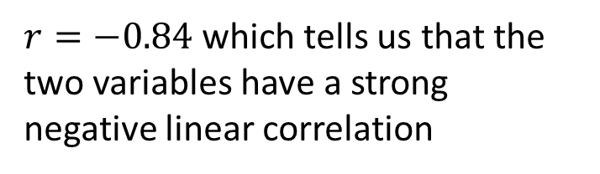
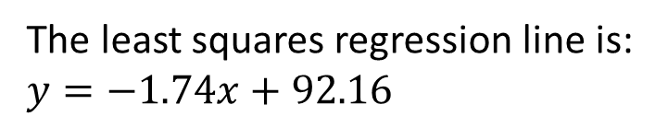
Unit 3 Chapter 2C
Now try Exercise 2C
Draw a scatterplot for the following data, calculate the least squares regression line, values of $′r′$ and ${′r}^{2′}$ to 2 decimal places and interpret the values.
The least squares regression line is: $y=−1.74x+92.16$
$r=−0.84$ which tells us that the two variables have a strong negative linear correlation
$r^{2}=0.71$ which tells us that 71% of the variation in the variables is explained by the linear relationship between them

